Slide 1

Heart Disease Prediction Using Gradio
Capstone Project
Joyce Rajendran Nadar
September 2024
NTUC

Slide 2
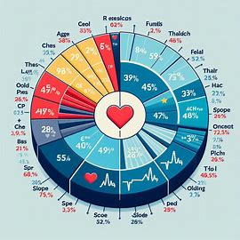
Introduction to Heart Disease
Heart disease is the leading cause of death globally.
Early prediction can save lives.
This project aims to develop a predictive model using machine learning.
Utilizes Gradio for an interactive interface.

Slide 3
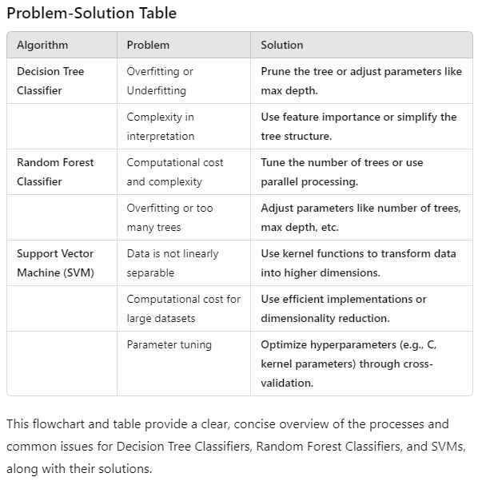
Problem
Difficulty in Early Detection: Heart disease often shows subtle symptoms, making early diagnosis challenging.
Limited Accessibility to Predictive Tools: Predictive tools and diagnostic methods may not be readily available in all regions or to all demographics.

Slide 4
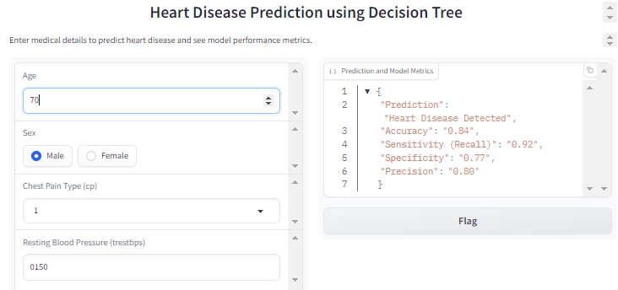
Solution - Aim
Create an Accessible Prediction Tool:
The goal is to develop a user-friendly, web-based heart disease prediction tool that can be used globally, even in regions with limited access to healthcare resources.

Slide 5
Solution - Approach
Flowchart/Timeline:
Data Collection: Gather medical data from patients (age, cholesterol levels, etc.).
Feature Selection: Identify the most relevant health indicators for heart disease.
Model Development: Use machine learning to build a prediction model.
User Interface: Develop an accessible interface using Gradio for users to input health metrics.
Deployment: Deploy the Gardio on Kaggle or other platforms for easy access.
This visual representation highlights the problem's scope and demonstrates the progression toward creating a solution that can help with early detection

Slide 6
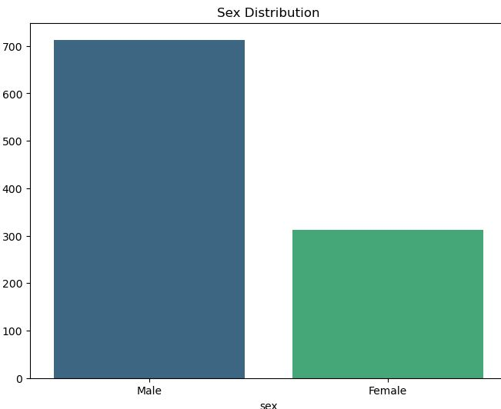
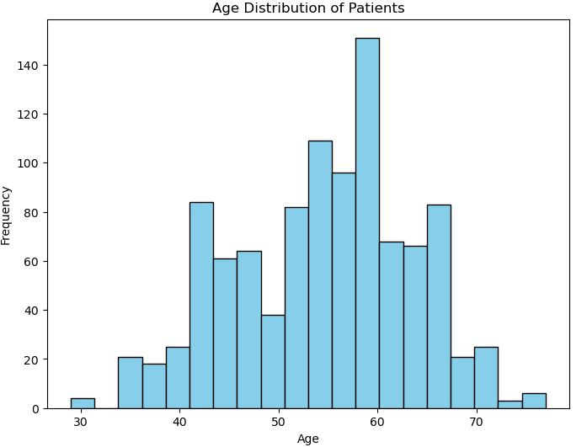
Exploratory Data Analysis (EDA)
Age distribution: Majority between 50-60 years.
High cholesterol strongly correlated with heart disease.
Insights guide feature selection

Slide 7
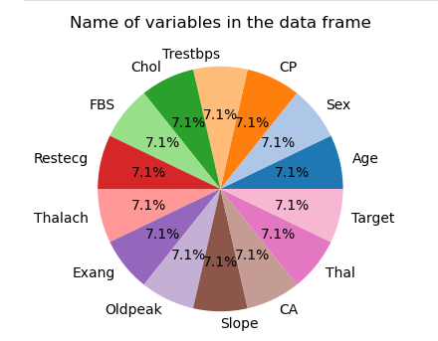
Key parameters
Parameter | Description
Age | Older age is linked to higher heart disease risk, influencing the likelihood of disease.
Sex | Gender plays a role, with different heart disease risks for males and females.
Chest Pain Type (CP) | Types of chest pain (e.g., typical angina) provide varying risk levels for heart disease.
Resting Blood Pressure (Trestbps) | High resting blood pressure signals cardiovascular risk.
Serum Cholesterol (Chol) | Elevated cholesterol increases heart disease risk.
Fasting Blood Sugar (FBS) | High blood sugar, linked to diabetes, raises heart disease risk.
Resting ECG Results (Restecg) | Abnormal ECG results may indicate heart disease.
Maximum Heart Rate (Thalach) | Lower max heart rate during exercise may suggest poor heart health.
Exercise-Induced Angina (Exang) | Exercise-related chest pain is a sign of coronary artery disease.
Exercise-Induced Depression (Oldpeak) | Depression during exercise can indicate more severe heart conditions.
Slope of ST Segment (Slope) | ST segment slope changes during exercise signal heart disease or ischemia.
Major Vessels Colored (CA) | More vessels visible in tests may indicate severe coronary artery disease.
Thalassemia (Thal) | Affects blood oxygenation and contributes to heart disease risk.
Notes:
A machine learning model uses these features to learn patterns and predict the likelihood of heart disease based on new data.

Slide 8
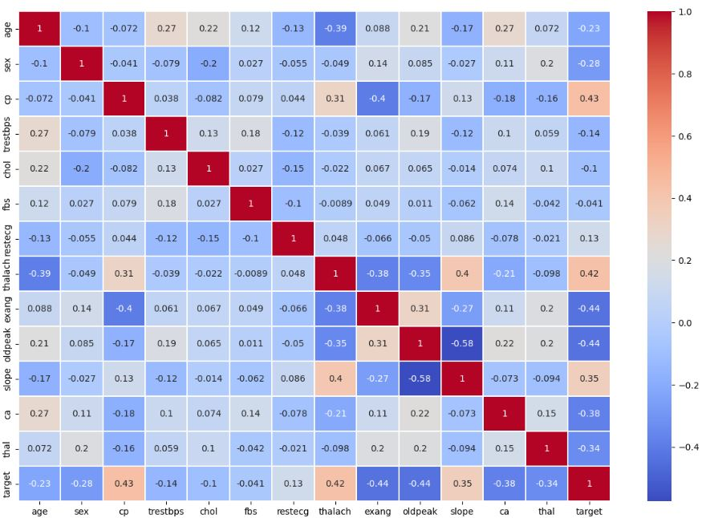
Feature Selection
Notes:
shows a series of histograms for various variables from the heart disease dataset (heart_info.csv). Each plot represents the distribution of values for a specific feature.

Slide 9
Feature Selection
The variables cp, thalach, slope, and target are positively correlated with heart disease, suggesting that these factors are common among patients with heart disease.
The variables exang, oldpeak, thal, and target have strong negative correlations, suggesting that as these variables increase, the likelihood of heart disease decreases.
This correlation analysis can guide feature selection for predictive modeling or give insights into the relationships between the variables in the dataset.

Slide 10
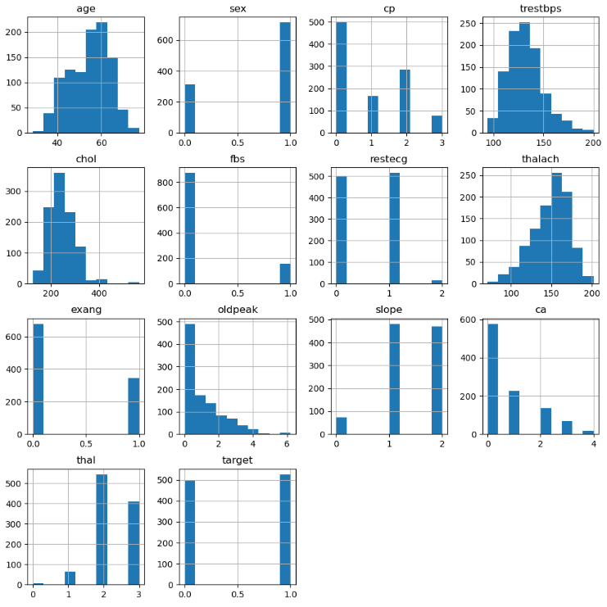
Feature Selection - Histogram

Slide 11
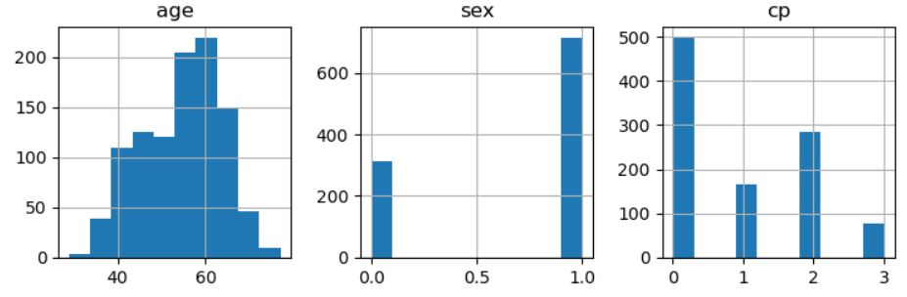
Feature Selection - Histogram
Age:
The distribution is slightly skewed to the right, with most patients in the 50-60 age range.
Sex:
This variable is binary, with more patients in category 1 (likely male) compared to category 0 (likely female).
Chest Pain Type (cp):
The most common chest pain type is category 0, with fewer patients in categories 2 and 3.

Slide 12
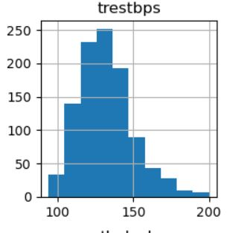
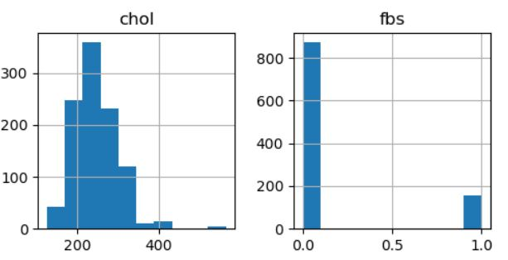
Feature Selection - Histogram
Resting Blood Pressure (trestbps):
This is a continuous variable, and the majority of patients have resting blood pressure between 120 and 140 mmHg.
Cholesterol (chol):
Cholesterol levels are spread, but most patients have values between 200 and 300 mg/dL.
Fasting Blood Sugar (fbs):
This is also binary, with most patients having fasting blood sugar below 120 mg/dL (0).

Slide 13
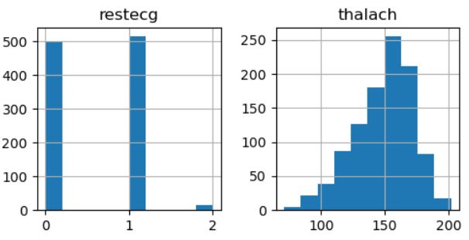
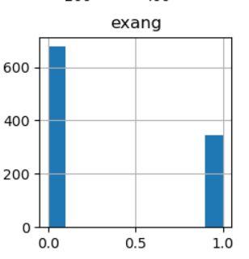
Feature Selection - Histogram
Resting Electrocardiographic Results (restecg):
Most patients fall in category 1, indicating normal ECG results, with fewer patients in categories 0 and 2.
Maximum Heart Rate Achieved (thalach):
This variable shows a nearly normal distribution, with the majority of patients having heart rates between 140 and 170 bpm.
Exercise-Induced Angina (exang):
Most patients do not experience exercise-induced angina (category 0), while fewer experience it (category 1).

Slide 14
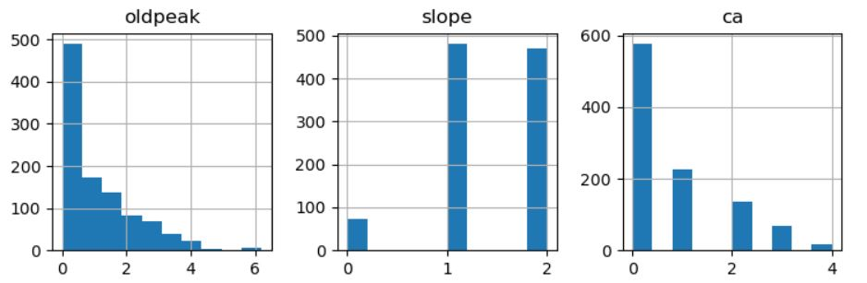
Feature Selection - Histogram
Oldpeak (ST depression):
The distribution is right-skewed, meaning most patients have low ST depression values.
Slope of the ST Segment (slope):
The most common slope is category 2, indicating a normal or flat slope, with fewer patients in category 0.
Number of Major Vessels Colored by Fluoroscopy (ca):
Most patients have 0 major vessels colored, with decreasing numbers for 1-3 vessels.

Slide 15
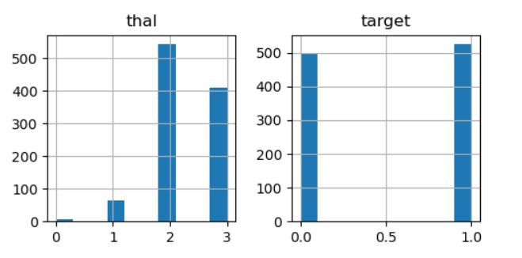
Feature Selection - Histogram
Thalassemia (thal):
Most patients fall in categories 2 and 3, with fewer in categories 1 and 0.
Target (Presence of Heart Disease):
This is a binary outcome, with 1 representing the presence of heart disease and 0 representing its absence. Most patients in the dataset likely have heart disease (category 1).

Slide 16
Model Selection
3 models were used for heart disease prediction
Decision Tree Classifier
Interpretable but struggles with non-linear relationships.
Random Forest
Handles complex interactions well. strong predictive performance and useful insights for feature selection.
SVM models
Powerful but computationally expensive and less interpretable.

Slide 17
Decision Tree Classifier
A Decision Tree Classifier is a machine learning algorithm used for classification tasks.
It creates a tree-like model where each internal node represents a decision based on a feature, branches represent outcomes, and leaf nodes represent class labels. The tree splits data recursively to make decisions, with the goal of classifying new samples based on the learned patterns.
It’s easy to interpret but can overfit if not managed properly.

Slide 18
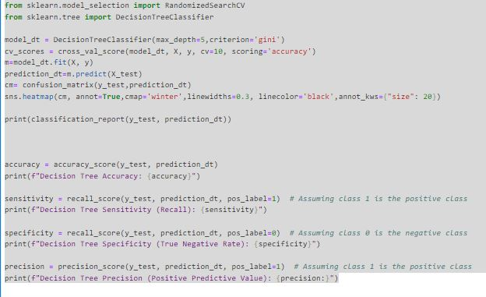
Decision Tree Classifier
Training accuracy: 90%.
Overfitting avoided with cross-validation.
Key metrics: Precision, recall, F1-score.

Slide 19
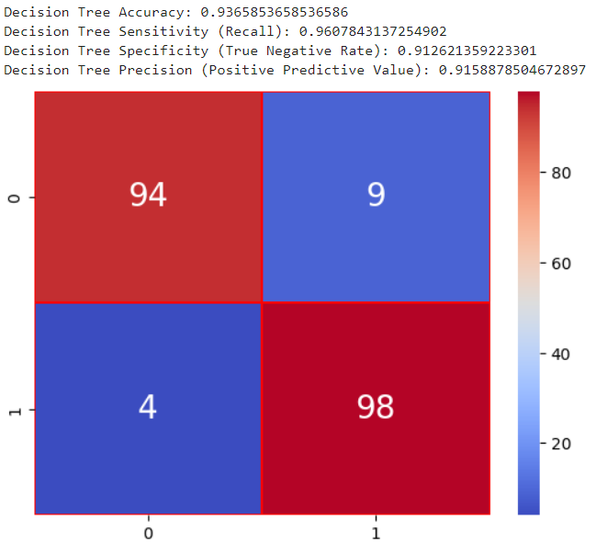
Decision Tree
The Decision Tree model performs well with an accuracy of 94%. Key metrics include:
Precision: 96% for class 0 and 92% for class 1, indicating high accuracy in predictions.
Recall (Sensitivity): 91% for class 0 and 96% for class 1, showing the model is slightly better at identifying positive cases (class 1).
F1-Score: 0.94 for both classes, reflecting a good balance between precision and recall.
Specificity (True Negative Rate): 91% for class 0, meaning the model correctly identifies most negative cases.
Overall, the model is strong but slightly better at detecting positive cases.

Slide 20
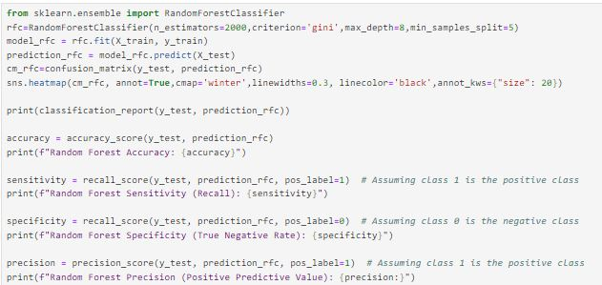
Random Forest Classifier
A Random Forest Classifier uses multiple decision trees to improve classification accuracy.
Each tree is trained on random data and features, and the final prediction is based on the majority vote from all trees.
It reduces overfitting, handles large and complex datasets well, and is robust to noise.

Slide 21
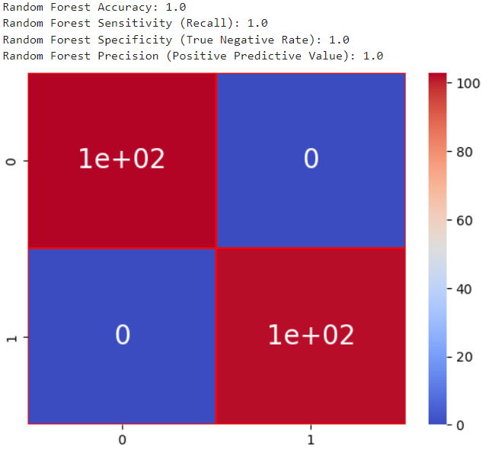


Random Forest Tree
The classification report and performance metrics show perfect scores across all categories of Random Forest model.
Here's an explanation of each metric:
1. Precision (1.00 for both classes):
Definition: Precision measures how many of the positive predictions made by the model are actually correct. It is calculated as:
Interpretation: Of the model, all positive predictions (both for class 0 and class 1) are correct, which is why precision is 1.00.
2. Recall (also known as Sensitivity) (1.00 for both classes):
Definition: Recall measures how many of the actual positive instances were correctly predicted by the model. It is calculated as:
​
Interpretation: model correctly predicted all actual positive instances, hence a recall of 1.00 for both classes.
Legend
True Positives (TP): Patients with heart disease correctly identified.
False Positives (FP): Patients without heart disease incorrectly identified as having it.
False Negatives (FN): Patients with heart disease incorrectly identified as healthy.

Slide 22
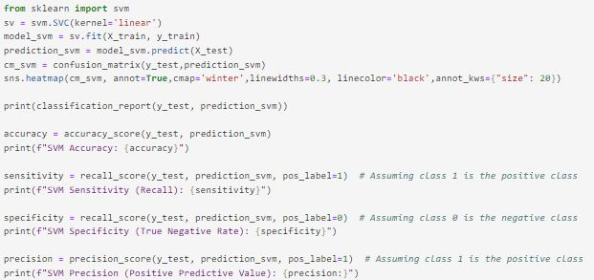
Support Vector Machine (SVM)
Support Vector Machine (SVM) is a classification and regression algorithm that finds the optimal hyperplane to separate different classes with the maximum margin.
It uses support vectors (closest points to the hyperplane) to define this boundary and can handle both linear and non-linear data through kernel functions.

Slide 23
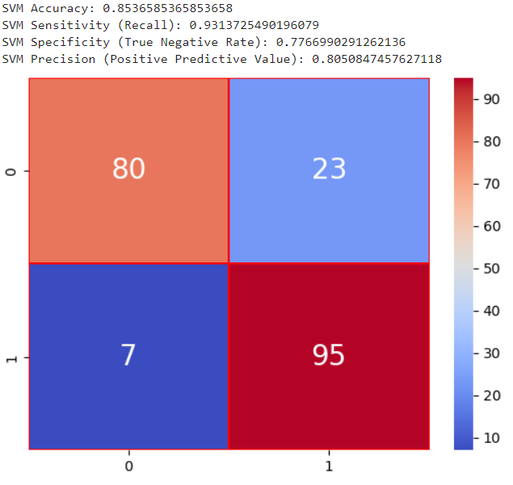
Support Vector Machine (SVM)
The Support Vector Machine (SVM) model has an accuracy of 85%. Key metrics include:
Precision: 92% for class 0 (negative) and 81% for class 1 (positive), showing better precision for class 0.
Recall: 78% for class 0 and 93% for class 1, indicating the model is better at identifying positive cases (class 1).
F1-Score: 0.84 for class 0 and 0.86 for class 1, reflecting overall balanced performance between precision and recall.
Specificity: 78% for class 0, meaning the model correctly identifies most negative cases.
Overall, the model performs better at detecting positive cases but struggles slightly with negative ones.

Slide 24
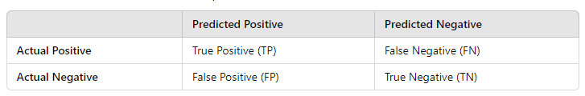


Gradio - Legend
Accuracy:
Measures the overall correctness of the model, including both true positives and true negatives.
Sensitivity:
Focuses on how many actual positive cases (heart disease) were correctly identified.
Specificity:
Focuses on how many actual negative cases (no heart disease) were correctly identified.
Precision:
Focuses on how many of the predicted positive cases (heart disease) were accurate, minimizing false positives.
True Positives (TP): Patients with heart disease correctly identified.
False Positives (FP): Patients without heart disease incorrectly identified as having it.
True Negatives (TN): Healthy patients correctly identified as not having heart disease.
False Negatives (FN): Patients with heart disease incorrectly identified as healthy.

Slide 25
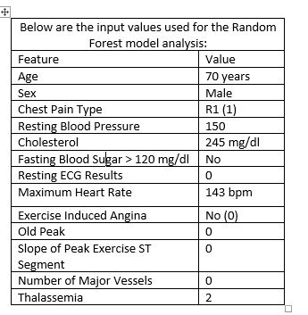
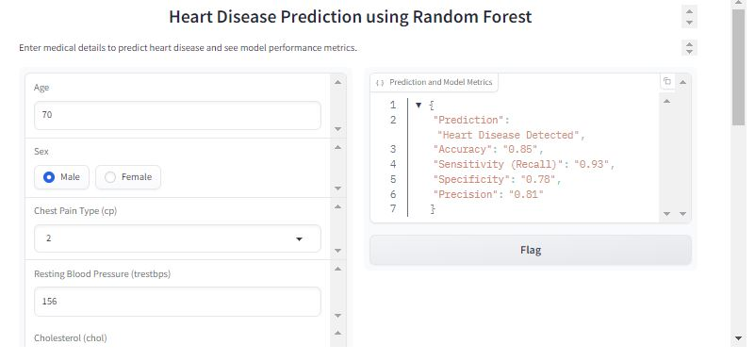
Gradio- Heart disease prediction using Random Forest
Conclusion
Using the Random Forest model, patient is 85 % likely to have heart disease based on the input parameters.

Slide 26
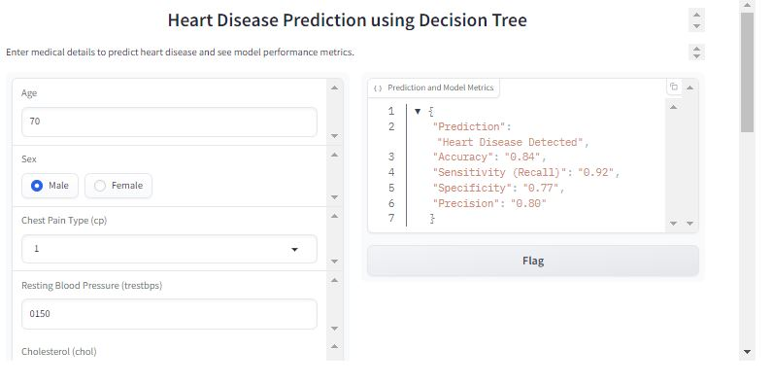
Gradio- Heart disease prediction using Decision Tree
Conclusion
Using the Decision Tree model, patient is 84 % likely to have heart disease based on the input parameters.

Slide 27
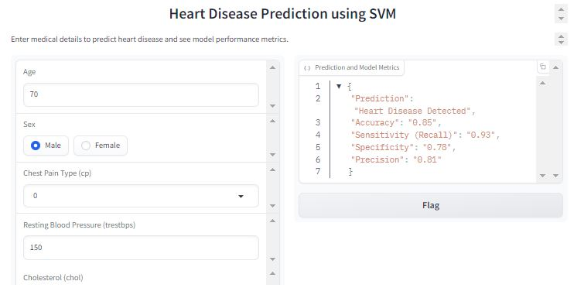
Gradio Heart Disease using SVM
Conclusion
Using the SVM model,patient is 86 % likely to have heart disease based on the input parameters.

Slide 28
Impact and Applications
User Testing and Feedback
Real-world impact: Potential to assist doctors in early diagnosis.
Can be expanded to other medical predictions.
Potential integration with health apps.
Conducted testing with users.
Positive feedback on ease of use.
Minor adjustments made based on feedback.

Slide 29
Future Work
Impact and Applications
Improve model accuracy with more data.
Explore deep learning models.
Expand Gradio app features.
Real-world impact: Potential to assist doctors in early diagnosis.
Can be expanded to other medical predictions.
Potential integration with health apps.

Slide 30
Conclusion
Successfully built a heart disease prediction model.
Integrated with Gradio for user interaction.
Project demonstrates the potential of AI in healthcare.

